Slide 1
Scope of today’s work
Recap
About normal melting and boiling point temperatures
Trouton’s and Richard’s rules for phase transitions, reasons for deviation
The thermodynamic definition of entropy (TDE)
Two more mysteries of thermodynamics
How entropies of phase transitions are measured

Slide 2
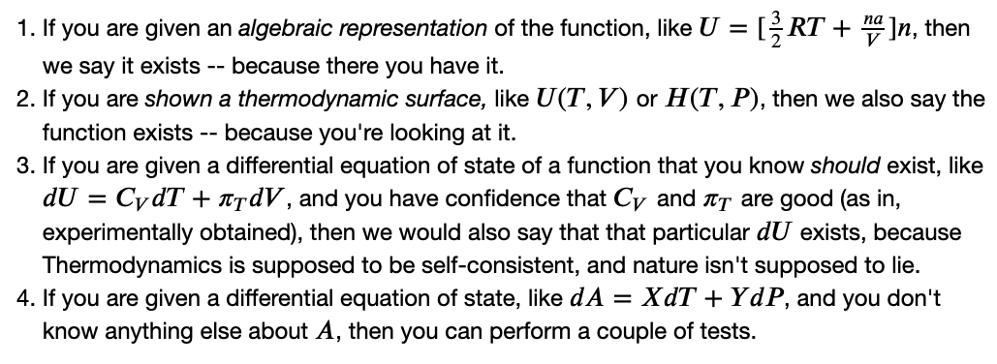
Recap
Existence check (CGI): testing whether A or B really is a state function
Using the cross-integration method
Using the cross-derivative method
An introduction to Maxwell’s equations and the box
A new thermodynamic identity: Euler’s Chain Rule
Two mysteries of thermodynamics revealed

Slide 3
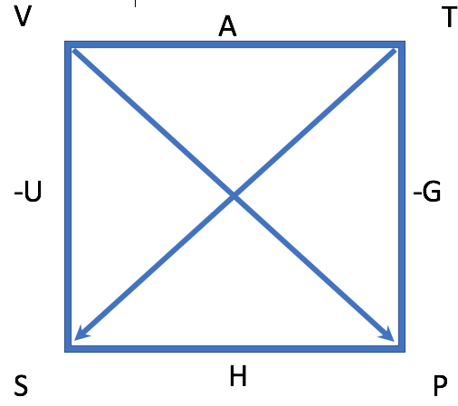
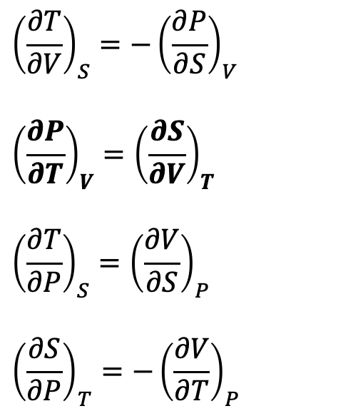
Recap
Existence check (CGI): testing whether A or B really is a state function
Using the cross-integration method
Using the cross-derivative method
An introduction to Maxwell’s equations and the box
A new thermodynamic identity: Euler’s Chain Rule
Two mysteries of thermodynamics revealed
$${\left(\frac{∂T}{∂V}\right)}_{S}=−{\left(\frac{∂P}{∂S}\right)}_{V}$$
$${\left(\frac{∂P}{∂T}\right)}_{V}={\left(\frac{∂S}{∂V}\right)}_{T}$$
$${\left(\frac{∂T}{∂P}\right)}_{S}={\left(\frac{∂V}{∂S}\right)}_{P}$$
$${\left(\frac{∂S}{∂P}\right)}_{T}=−{\left(\frac{∂V}{∂T}\right)}_{P}$$

Slide 4
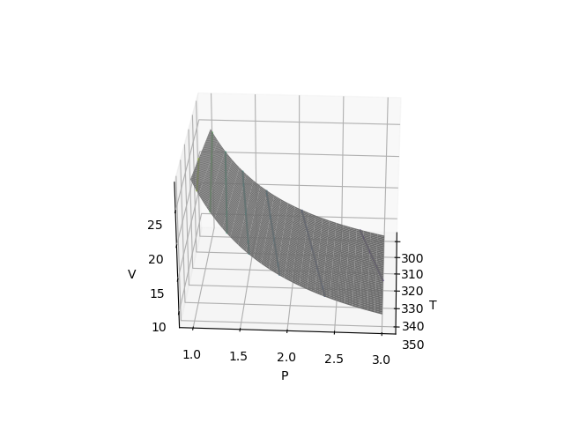
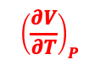
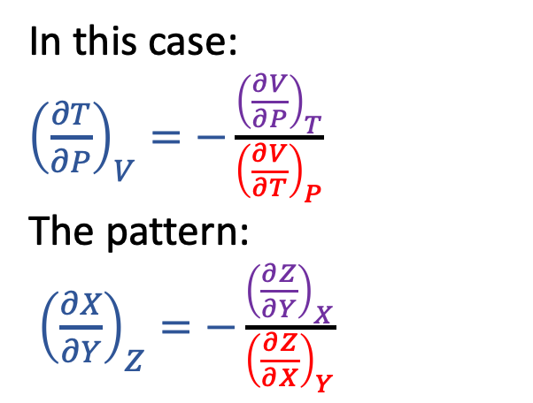
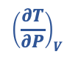
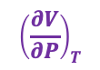
Recap
Existence check (CGI): testing whether A or B really is a state function
Using the cross-integration method
Using the cross-derivative method
An introduction to Maxwell’s equations and the box
A new thermodynamic identity: Euler’s Chain Rule
Two mysteries of thermodynamics revealed
In this case:
${\left(\frac{∂T}{∂P}\right)}_{V}=−\frac{{\left(\frac{∂V}{∂P}\right)}_{T}}{{\left(\frac{∂V}{∂T}\right)}_{P}}$
The pattern:
${\left(\frac{∂X}{∂Y}\right)}_{Z}=−\frac{{\left(\frac{∂Z}{∂Y}\right)}_{X}}{{\left(\frac{∂Z}{∂X}\right)}_{Y}}$
$${\left(\frac{∂V}{∂T}\right)}_{P}$$
$${\left(\frac{∂V}{∂P}\right)}_{T}$$
$${\left(\frac{∂T}{∂P}\right)}_{V}$$

Slide 5

Recap
Existence check (CGI): testing whether A or B really is a state function
Using the cross-integration method
Using the cross-derivative method
An introduction to Maxwell’s equations and the box
A new thermodynamic identity: Euler’s Chain Rule
Two mysteries of thermodynamics revealed
#1 … why $dS=\frac{C_{P}}{T}dT−α_{P}VdP$
#2 … why $dS=\frac{C_{V}}{T}dT+\frac{α_{P}}{κ_{T}}dV$

Slide 6
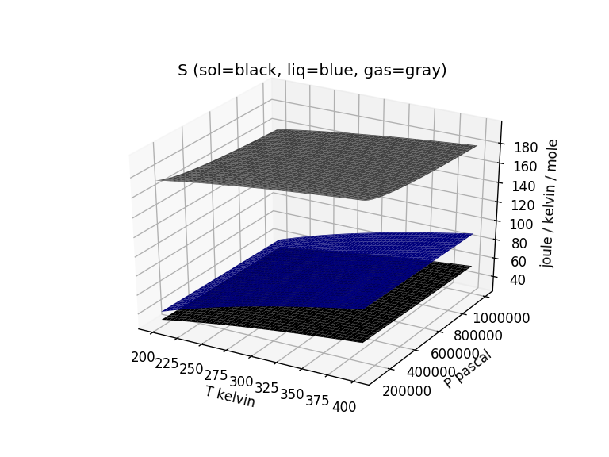
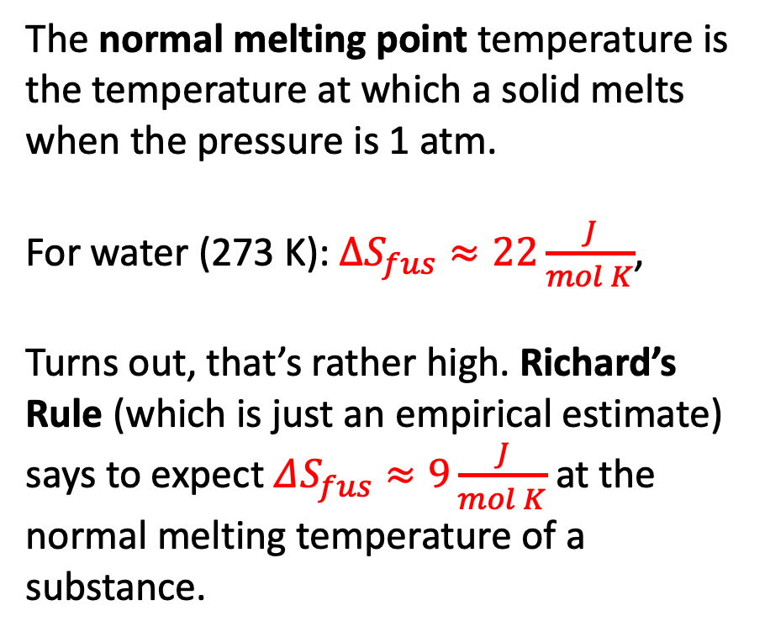
Normal melting and boiling points
The normal melting point temperature is the temperature at which a solid melts when the pressure is 1 atm.
For water (273 K): $∆S_{fus}≈22\frac{J}{mol K}$,
Turns out, that’s rather high. Richard’s Rule (which is just an empirical estimate) says to expect $ΔS_{fus}≈9\frac{J}{mol K}$ at the normal melting temperature of a substance.

Slide 7
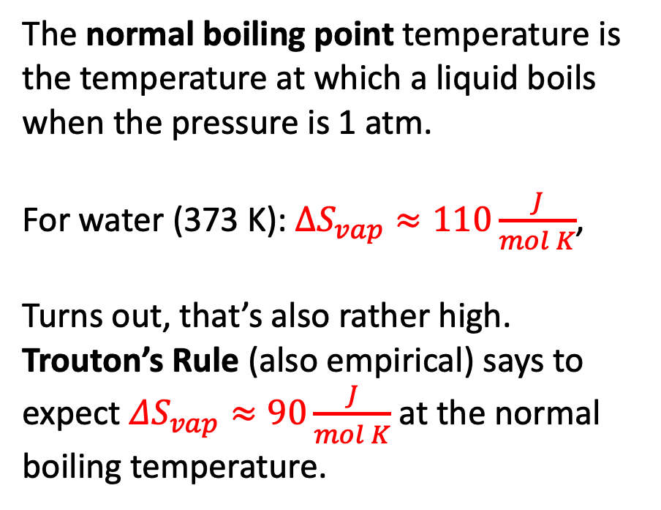
Normal melting and boiling points
The normal boiling point temperature is the temperature at which a liquid boils when the pressure is 1 atm.
For water (373 K): $∆S_{vap}≈110\frac{J}{mol K}$,
Turns out, that’s also rather high. Trouton’s Rule (also empirical) says to expect $ΔS_{vap}≈90\frac{J}{mol K}$ at the normal boiling temperature.

Slide 8
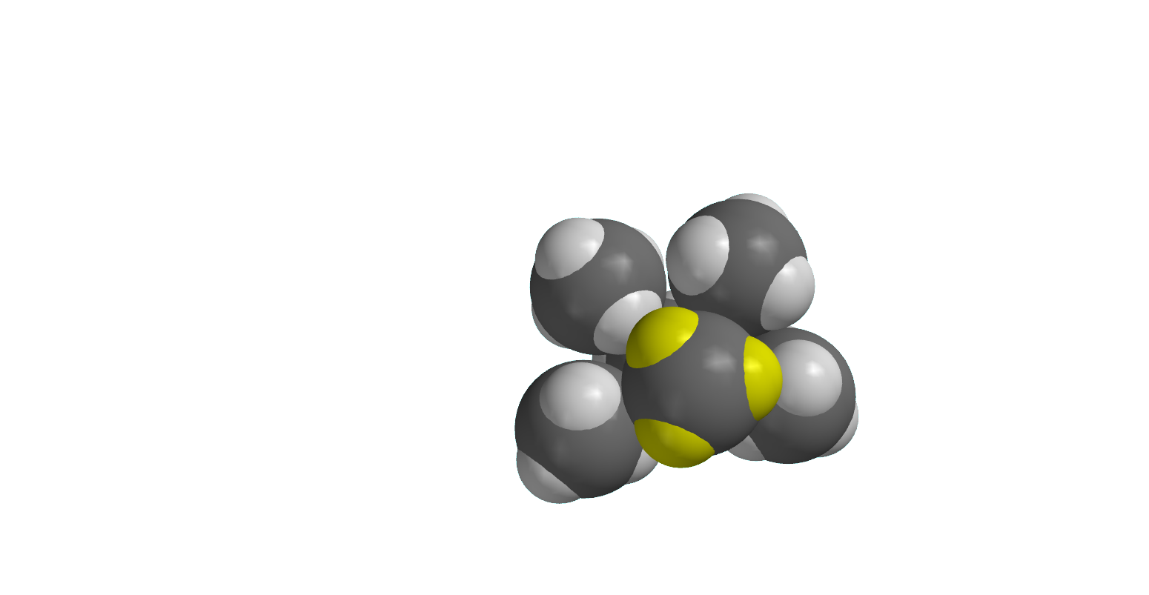
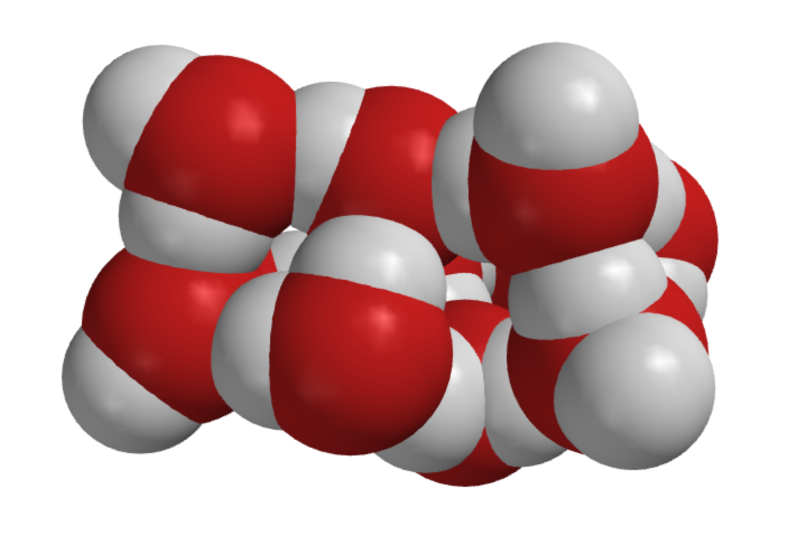
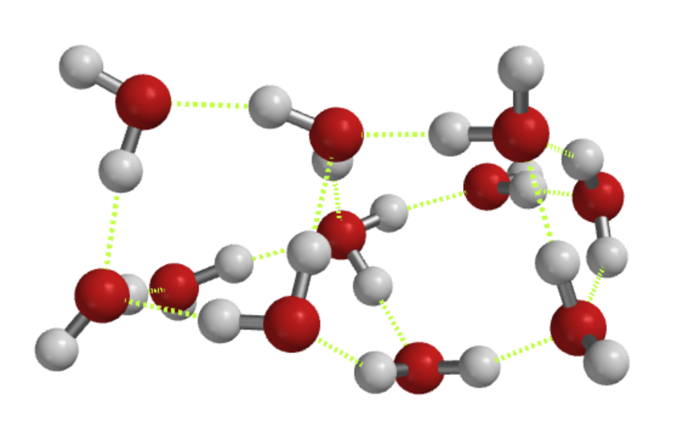
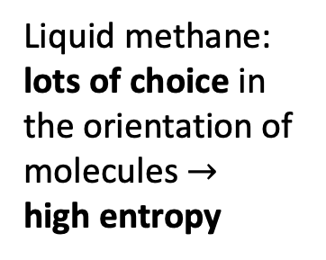
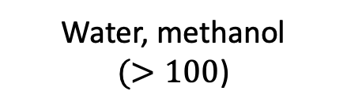
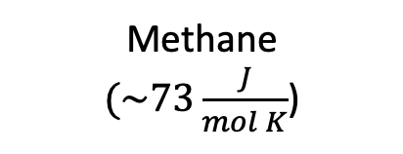
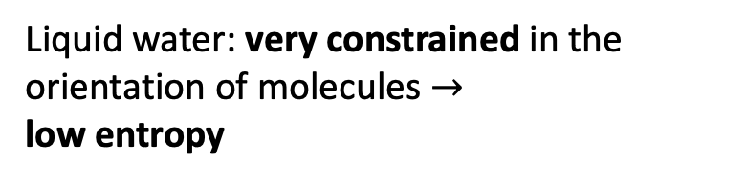
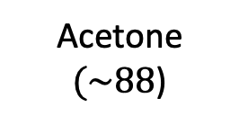
Why $∆S_{vap}$ of water is so big
Methane
$(\sim 73\frac{J}{mol K}$)
Acetone
$(\sim 88$)
Water, methanol
$(>100$)
Liquid water: very constrained in the orientation of molecules $→$
low entropy
Liquid methane: lots of choice in the orientation of molecules $→$
high entropy
Notes:
https://slideplayer.com/slide/7362502/

Slide 9
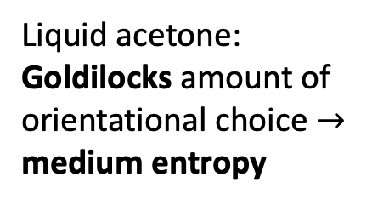
Why $∆S_{vap}$ of water is so big
Methane
$(\sim 73\frac{J}{mol K}$)
Acetone
$(\sim 88$)
Water, methanol
$(>100$)
Liquid water: very constrained in the orientation of molecules $→$
low entropy
Liquid methane: lots of choice in the orientation of molecules $→$
high entropy
Liquid acetone: Goldilocks amount of orientational choice $→$
medium entropy
Notes:
https://slideplayer.com/slide/7362502/

Slide 10
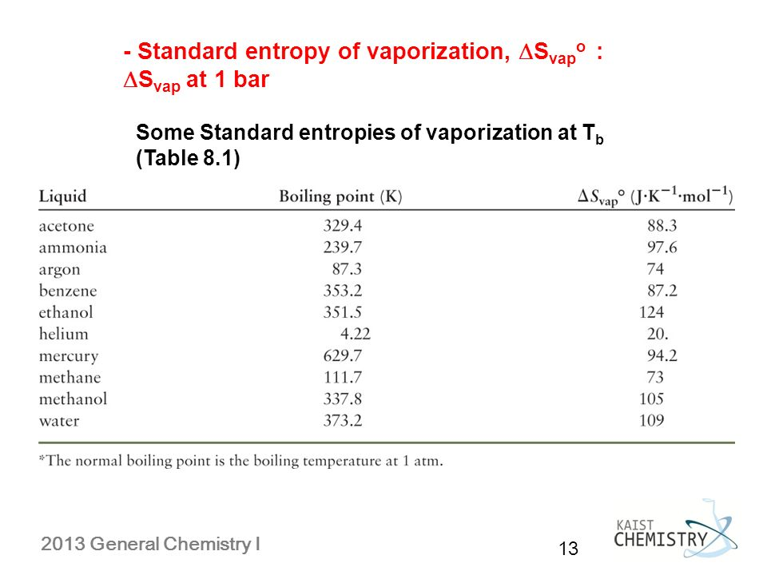
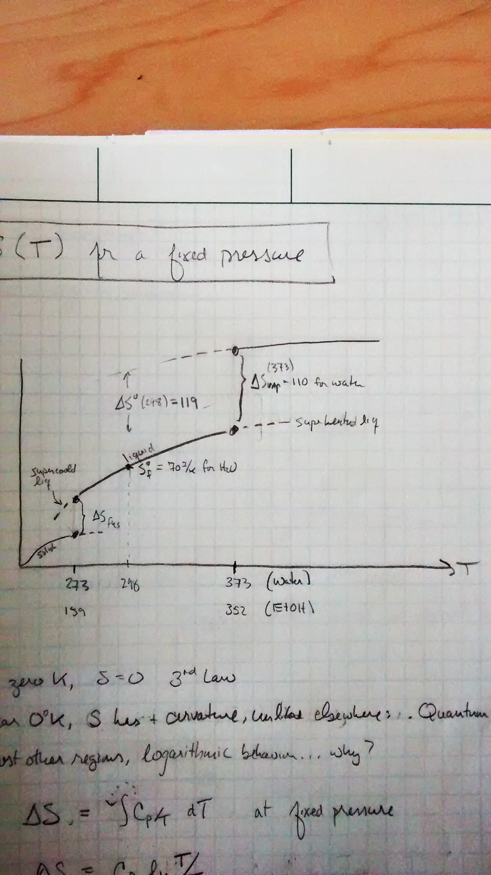
Summarizing some of these ideas
S
Standard state entropies of formation (from a table)
What Richard’s rule approximates (and some tables tell you precisely)
What Trouton’s rule approximates (and some tables tell you precisely)

Slide 11
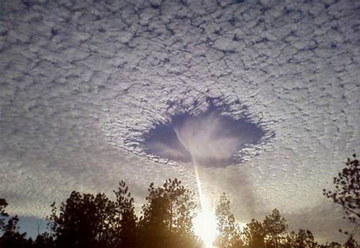
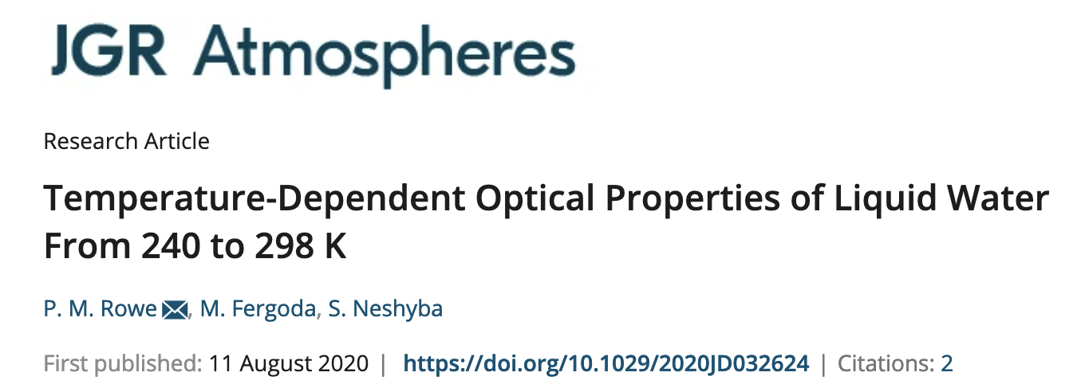
Supercooling and superheating
https://forum.xcitefun.net/punch-hole-clouds-layer-of-supercooled-clouds-t16564.html
S

Slide 12
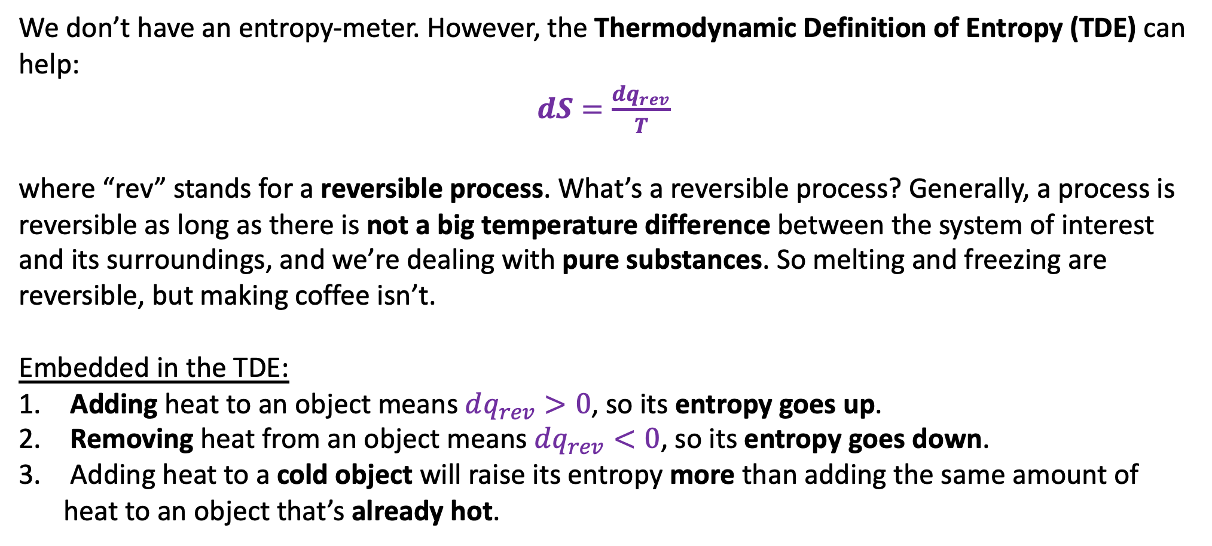
Thermodynamic Definition of Entropy (TDE)
We don’t have an entropy-meter. However, the Thermodynamic Definition of Entropy (TDE) can help:
$dS=\frac{dq_{rev}}{T}$
where “rev” stands for a reversible process. What’s a reversible process? Generally, a process is reversible as long as there is not a big temperature difference between the system of interest and its surroundings, and we’re dealing with pure substances. So melting and freezing are reversible, but making coffee isn’t.
Embedded in the TDE:
Adding heat to an object means $dq_{rev}>0$, so its entropy goes up.
Removing heat from an object means $dq_{rev}<0$, so its entropy goes down.
Adding heat to a cold object will raise its entropy more than adding the same amount of heat to an object that’s already hot.

Slide 13
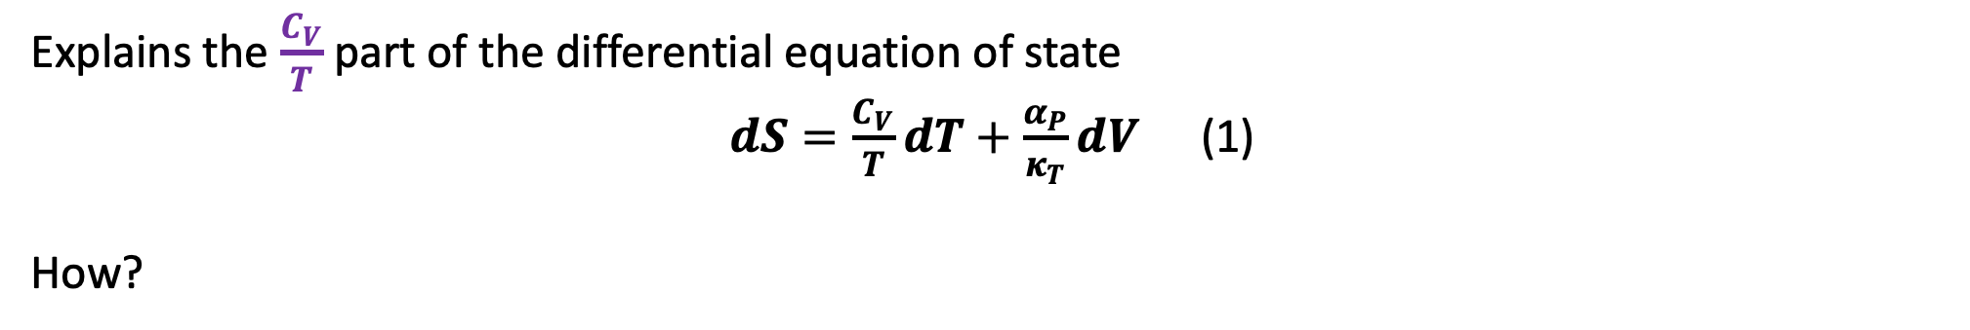
One use of the TDE: explains the “$dT$” parts of the $dS=$ … equations of state
Explains the $\frac{C_{V}}{T}$part of the differential equation of state
$dS=\frac{C_{V}}{T}dT+\frac{α_{P}}{κ_{T}}dV$ (1)
How?

Slide 14
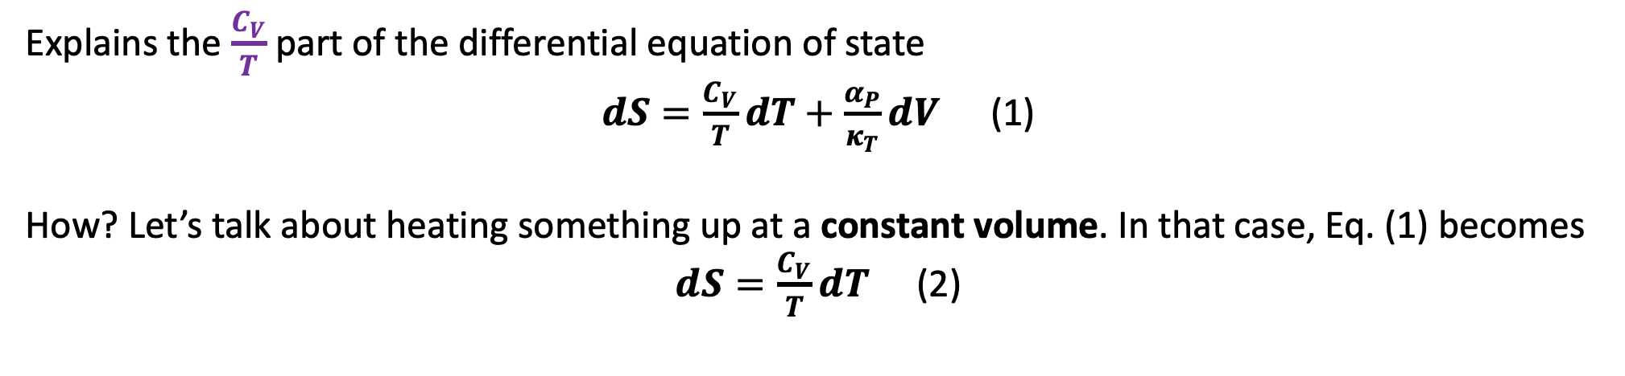
One use of the TDE: explains the “𝒅𝑻” parts of the 𝒅𝑺= … equations of state
Explains the $\frac{C_{V}}{T}$part of the differential equation of state
$dS=\frac{C_{V}}{T}dT+\frac{α_{P}}{κ_{T}}dV$ (1)
How? Let’s talk about heating something up at a constant volume. In that case, Eq. (1) becomes
$dS=\frac{C_{V}}{T}dT$ (2)

Slide 15
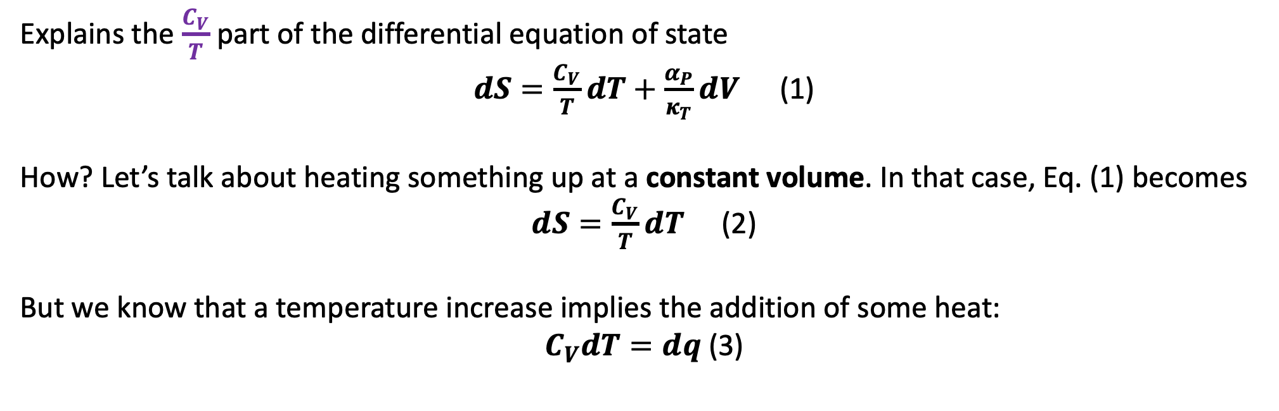
One use of the TDE: explains the “𝒅𝑻” parts of the 𝒅𝑺= … equations of state
Explains the $\frac{C_{V}}{T}$part of the differential equation of state
$dS=\frac{C_{V}}{T}dT+\frac{α_{P}}{κ_{T}}dV$ (1)
How? Let’s talk about heating something up at a constant volume. In that case, Eq. (1) becomes
$dS=\frac{C_{V}}{T}dT$ (2)
But we know that a temperature increase implies the addition of some heat:
$C_{V}dT=dq$(3)

Slide 16
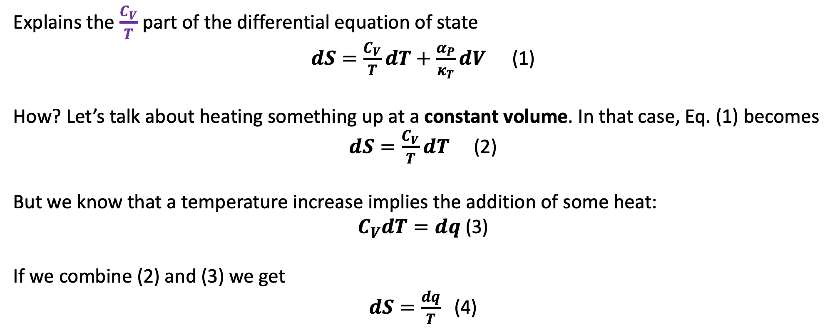
One use of the TDE: explains the “𝒅𝑻” parts of the 𝒅𝑺= … equations of state
Explains the $\frac{C_{V}}{T}$part of the differential equation of state
$dS=\frac{C_{V}}{T}dT+\frac{α_{P}}{κ_{T}}dV$ (1)
How? Let’s talk about heating something up at a constant volume. In that case, Eq. (1) becomes
$dS=\frac{C_{V}}{T}dT$ (2)
But we know that a temperature increase implies the addition of some heat:
$C_{V}dT=dq$(3)
If we combine (2) and (3) we get
$dS=\frac{dq}{T}$ (4)

Slide 17
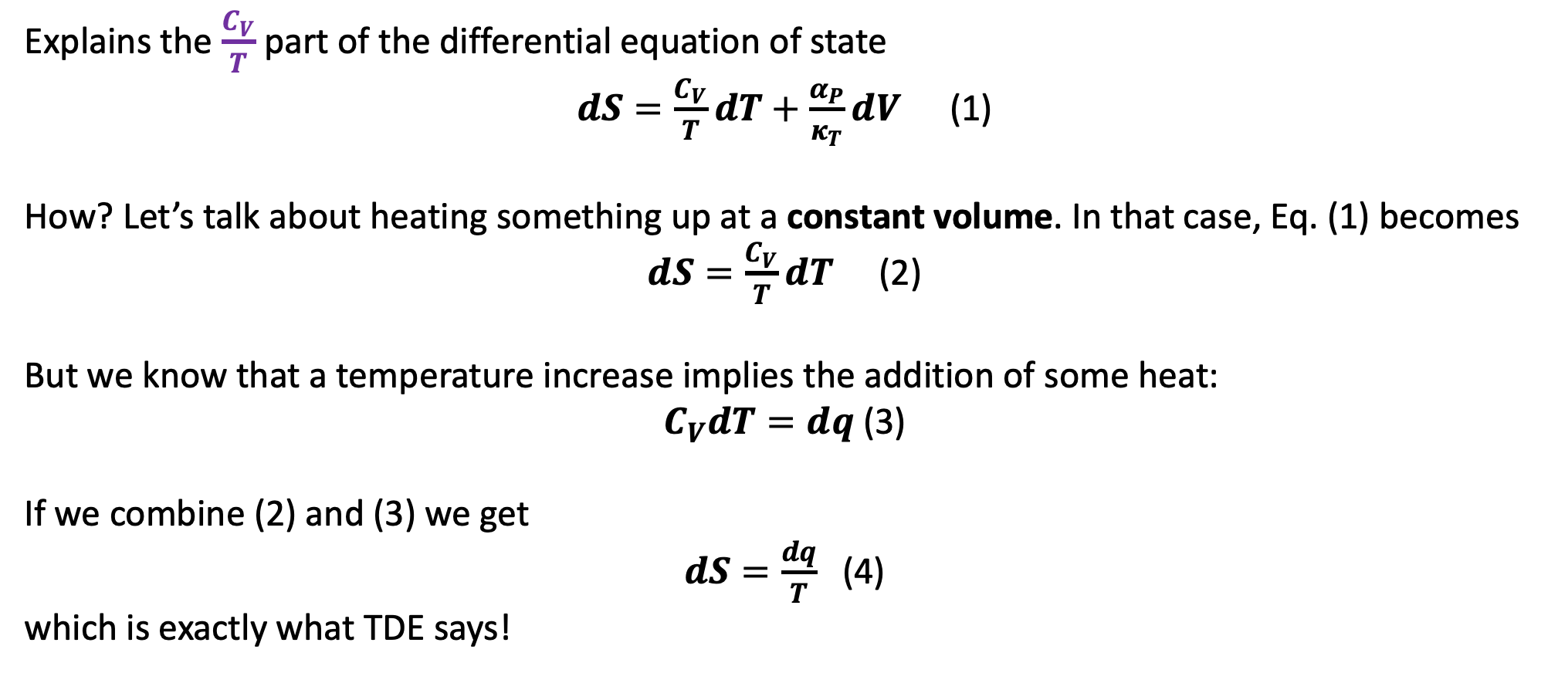
One use of the TDE: explains the “𝒅𝑻” parts of the 𝒅𝑺= … equations of state
Explains the $\frac{C_{V}}{T}$part of the differential equation of state
$dS=\frac{C_{V}}{T}dT+\frac{α_{P}}{κ_{T}}dV$ (1)
How? Let’s talk about heating something up at a constant volume. In that case, Eq. (1) becomes
$dS=\frac{C_{V}}{T}dT$ (2)
But we know that a temperature increase implies the addition of some heat:
$C_{V}dT=dq$(3)
If we combine (2) and (3) we get
$dS=\frac{dq}{T}$ (4)
which is exactly what TDE says!

Slide 18
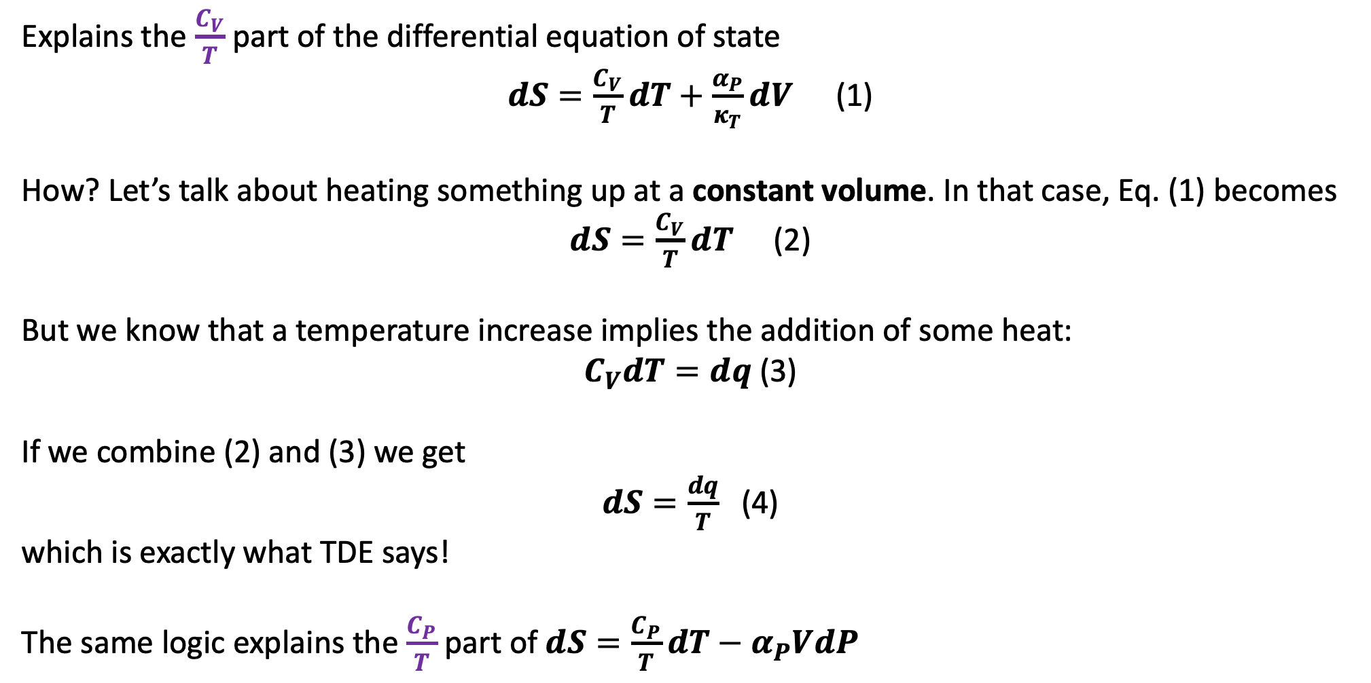
One use of the TDE: explains the “𝒅𝑻” parts of the 𝒅𝑺= … equations of state
Explains the $\frac{C_{V}}{T}$part of the differential equation of state
$dS=\frac{C_{V}}{T}dT+\frac{α_{P}}{κ_{T}}dV$ (1)
How? Let’s talk about heating something up at a constant volume. In that case, Eq. (1) becomes
$dS=\frac{C_{V}}{T}dT$ (2)
But we know that a temperature increase implies the addition of some heat:
$C_{V}dT=dq$(3)
If we combine (2) and (3) we get
$dS=\frac{dq}{T}$ (4)
which is exactly what TDE says!
The same logic explains the $\frac{C_{P}}{T}$ part of $dS=\frac{C_{P}}{T}dT−α_{P}VdP$

Slide 19
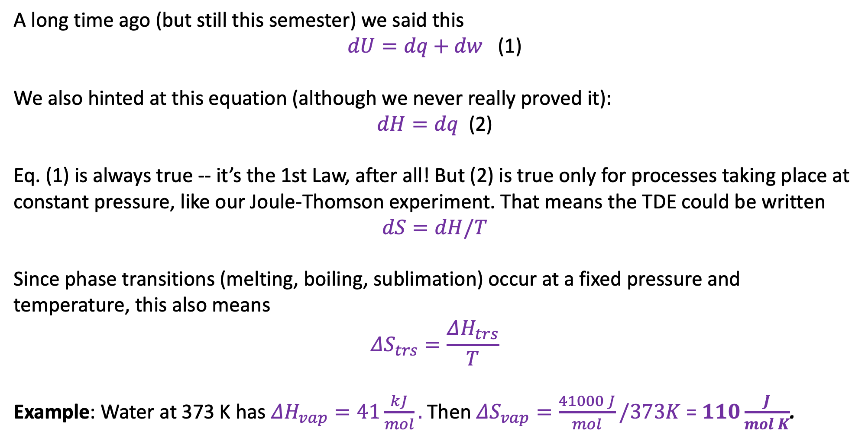
Another use of the TDE: to measure entropies of phase transitions
A long time ago (but still this semester) we said this
$dU=dq+dw$ (1)
We also hinted at this equation (although we never really proved it):
$dH=dq$ (2)
Eq. (1) is always true -- it’s the 1st Law, after all! But (2) is true only for processes taking place at constant pressure, like our Joule-Thomson experiment. That means the TDE could be written
$$dS=dH/T$$
Since phase transitions (melting, boiling, sublimation) occur at a fixed pressure and temperature, this also means
$$ΔS_{trs}=\frac{ΔH_{trs}}{T}$$
Example: Water at 373 K has $ΔH_{vap}=41\frac{kJ}{mol}.$Then $ΔS_{vap}=\frac{41000 J}{mol}/373K$ = $110\frac{J}{mol K}$.

Slide 20
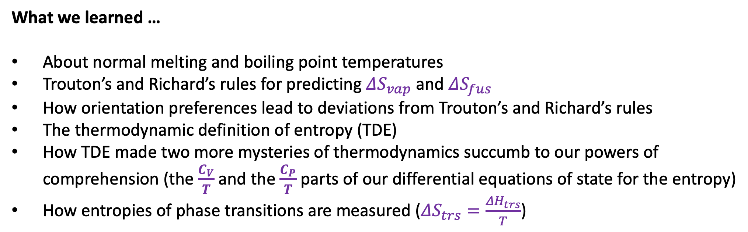
What we learned …
About normal melting and boiling point temperatures
Trouton’s and Richard’s rules for predicting $ΔS_{vap}$ and $ΔS_{fus}$
How orientation preferences lead to deviations from Trouton’s and Richard’s rules
The thermodynamic definition of entropy (TDE)
How TDE made two more mysteries of thermodynamics succumb to our powers of comprehension (the $\frac{C_{V}}{T}$and the $\frac{C_{P}}{T}$parts of our differential equations of state for the entropy)
How entropies of phase transitions are measured ($ΔS_{trs}=\frac{ΔH_{trs}}{T}$)

